Slide 1
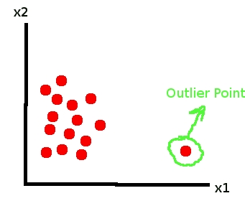
Machine Learning Based Anomaly Detection for CSNSE
Ed Henry, Derick Winkworth and David Meyer

Slide 2
Agenda
Introduction 25 minutes
What is an ML application?
So What Are Anomalies?
Anomaly Detection Schemes
A bit on k-Nearest Neighbors
Why algorithms like k-NN or K-Means aren’t the endgame
Derick on Generalization Graphs for Machine Learning 25 minutes
Ed on Anomaly Detection Prototypes 25 minutes
Business Models for ML Discussion
Q&A

Slide 3
What is an ML application?
We would like to have general purpose ML applications
The good news is that in some domains we have this
e.g., AlexNet (object/scene recognition)
Available in Caffe
Trained on the the Imagenet dataset
1.6M images, 60K classes
Transfer learning
Ability to apply knowledge learned in one context to a new context
Requires sophisticated/powerful models
Mature data, data types, and metrics
http://www.image-net.org/

Slide 4
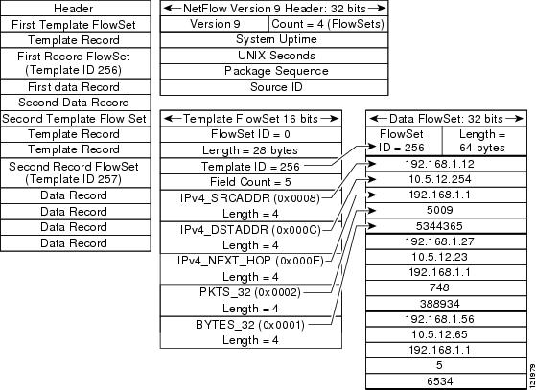
However…
ML for networking is in its infancy
Data hard to acquire, even if you own it
and network data is extremely noisy/dirty
No standard data formats
looks like flow/IPFIX is the most standard
logs , packets, files, alerts, thread feeds, Chef recipes, …
No algorithm performance benchmarks
contrast CNNs for object/scene recognition
The good news: plenty of room for innovation
The bad news: everyone is starting to realize this
Literally 100s of startups in the ML space

Slide 5

Summary: Issues/Challenges
Is there a unique model that we can use?
Probably not, as CSNSE infrastructure varies widely
Concept Drift
Averaging models over training sets and over time will help
Scores
Network data is non-perceptual
Does the Manifold Hypothesis hold for non-perceptual data sets?
Seems to (Google PUE, etc)
Unlabeled vs. Labeled Data
Most commercial successes in ML have come with deep supervised
We don’t have ready access to large labeled data sets (always a problem)
Time Series Data
With the exception of Recurrent Neural Networks, most ANNs do not explicitly model time
Flow data/sampling
Training vs. {prediction,classification} Complexity
Stochastic (online) vs. Batch vs. Mini-batch
Where are the computational bottlenecks/interaction with real time requirements?
Technical Skills
ML today is largely a technical (mathematical) discipline
Locating Attack Signals
For example, some internal attacks can in general only be discovered by correlating “weak” signals over time
Unique attacks against the threat monitoring /remediation system
Training set poisoning

Slide 6
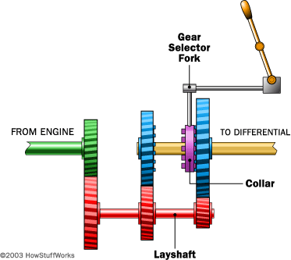
Business Models?
No “black-box” ML applications for networking…yet
Still need to have intimate knowledge of both data and algorithms to be successful
This is continue for the foreseeable future
→ No “one-size-fits-all” ML applications for networking
vs. something like Flow Optimizer
And likely to be a combination of algorithms, heuristics, and datasets
More likely is that we will have “systems” that leverage a wide number of algorithms and datasets
IBM, Spark, Niara, Darktrace, Threatstream, …
Switching gears for a moment…

Slide 7
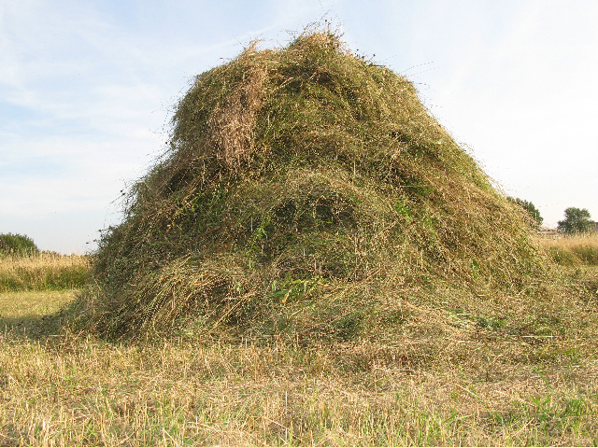
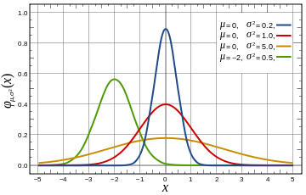
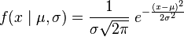
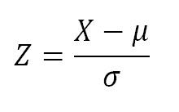
Anomaly Detection: What and Why
It is clear that one of the major challenges we face as a civilization is dealing with deluge of data that are being collected from our networks at global (and beyond) scale
While at the same time we are “knowledge starved”
Can’t find the needles in an exponentially growing haystack
Anomaly Detection (aka “Outlier detection”) is one piece of the puzzle
Machine Learning is a fundamental part of the answer
Key Assumption for Anomaly Detection
Anomalous events occur relatively infrequently (alternatively: most events normal)
Second order assumption: Common events follow a Gaussian distribution (likely to be wrong)
What is obvious: When anomalous events do occur, their consequences can be quite serious and often have substantial negative impact on our businesses, security, …

Slide 8
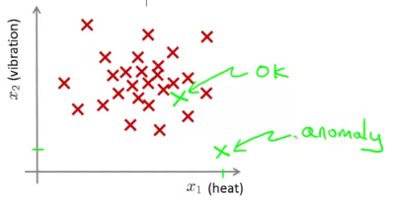
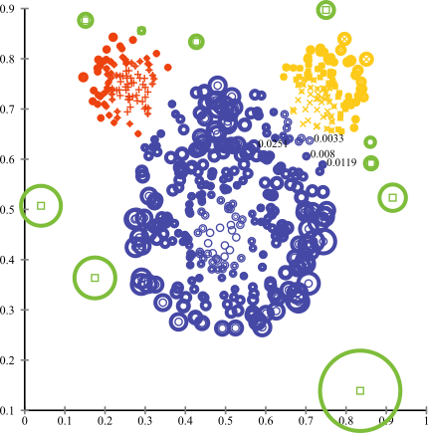
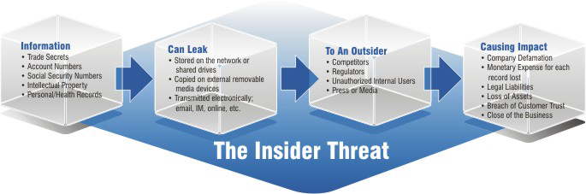
So What are Anomalies?
An anomaly is a pattern that does not conform to the expected behaviour
An observation that deviates so significantly from other observations
so as to arouse suspicion that it was generated by a different mechanism, or just far from expected…
How to define expected behaviour?
How to find the “outliers”?
Anomalies translate to significant real life events
Cyber intrusions
Cyber crime
Manufacturing/product defects
…
Linear Decision Boundary
Graphic courtesy Andrew Ng, others

Slide 9
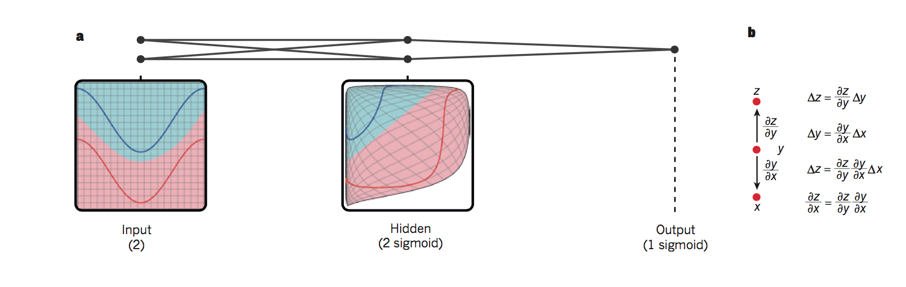
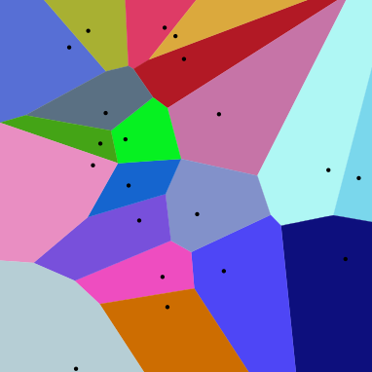
BTW, What is Really Happening Here?
Linear Decision Boundary
Target function represented by input data is some twisted up manifold
Deep Nets disentangle the underlying explanatory
factors in the data so as to make them linearly separable
Graphic courtesy Christopher Olah
Voronoi diagram under Euclidian distance
Voronoi diagram under Euclidian distance
Linear Separability in a Neural Network
Linear Separability in a Neural Network

Slide 10
Basic Idea Behind Anomaly Detection
An anomaly
Idea: Assume that a boundary exists and that - Nominal data is inside the boundary - Anomalous data is outside the boundary
Problem: How to estimate/approximate the boundary?
Problem: What measurement(s) caused the anomaly?
Collected ‘Nominal’ Data
Problem: How far off-nominal is the anomaly/feature?

Slide 11
Simple Example
N₁ and N₂ are regions of normal behaviour
Say, normal flows in a network
Points o₁ and o₂ are anomalies
Points in region O₃ are anomalies
Challenge:
How to define “normal” regions?
How to find the outlier points?
This is the job of machine learning
Y
N₁
o₁
O₃
o₂
N₂
X

Slide 12
3 Main Types of Anomaly
Point Anomalies
Contextual Anomalies
Collective Anomalies

Slide 13
Point Anomalies
An individual data instance is anomalous if it deviates significantly from the rest of the data set.
Y
Anomaly
N₁
o₁
O₃
o₂
N₂
X

Slide 14
Contextual Anomalies
Individual data instance is anomalous within a context
Requires a notion of context
Also referred to as conditional anomalies
Anomaly
Normal

Slide 15
Collective Anomalies
A collection of related data instances is anomalous
Requires a relationship among data instances
Sequential Data
Spatial Data
Graph Data
The individual instances within a collective anomaly are not anomalous by themselves
Anomalous Subsequence
Anomalous Subsequence

Slide 16
Key Challenges for Anomaly Detection Algorithms
Defining a representative normal region is challenging
The boundary between normal and outlying behaviour is often not precise
The exact notion of an outlier is different for different application domains
Availability of labelled data for training/validation (supervised learning)
Malicious adversaries
Data is very noisy
False positive/negatives
Normal behaviour keeps evolving

Slide 17
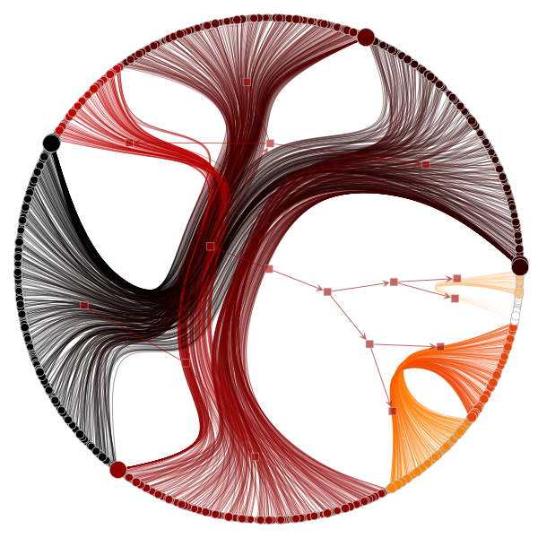
One Way To Visualize Anomalous Behavior (Derick will explain this in a few minutes)

Slide 18
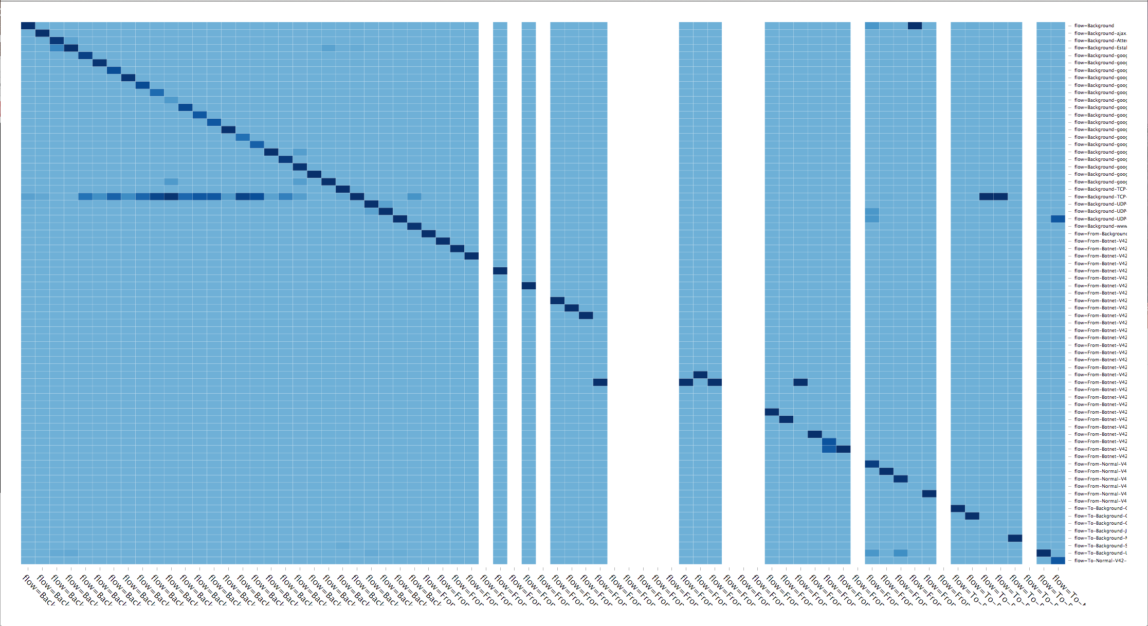
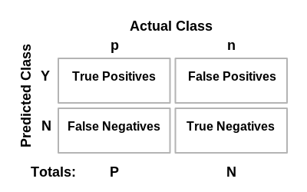
Another Way – Confusion Matrix (Ed will explain this in a few minutes)
Briefly: What is a confusion matrix?

Slide 19
Agenda
Introduction 25 minutes
What is an ML application?
So What Are Anomalies?
Anomaly Detection Schemes
A bit on k-Nearest Neighbors
Why algorithms like k-NN or K-Means aren’t the endgame
Derick on Generalization Graphs for Machine Learning 25 minutes
Ed on Anomaly Detection Prototypes 25 minutes
Business Models for ML Discussion
Q&A

Slide 20

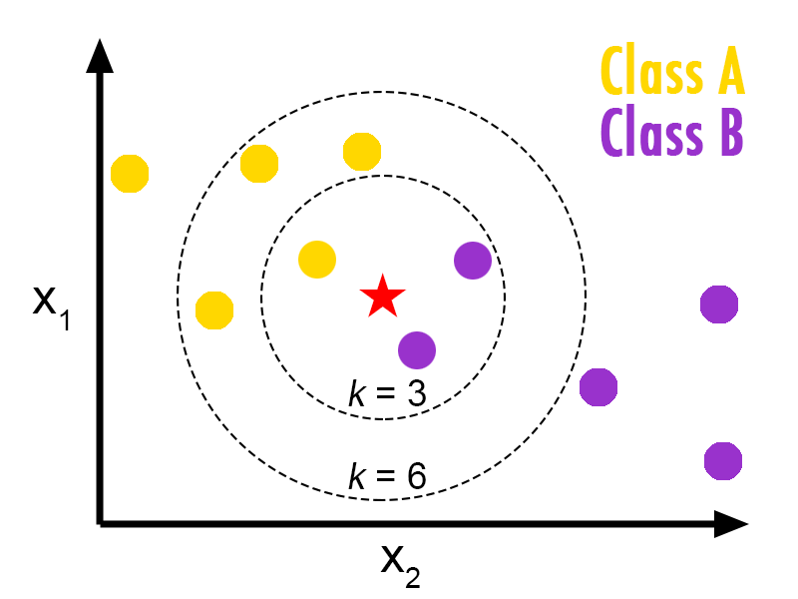
Really Simple Anomaly Detection k-Nearest Neighbors
Instance-Based Learning
Very Simple Algorithm
Given a training set {(x_{i},y_{i}),…,(x_{n},y_{n})}
Do nothing (lazy learner, supervised learning)
Given an instance x_{q} to classify
Find the instance x_{i} that is most similar to x_{q}
Return the class value of x_{i}, namely y_{i}
Task: Classify the green point
Idea: data points that are “similar” are likely
to be in the same object class (smoothness)
The hyper-parameter k describes how many similar neighbors
to consider. Neighbors then “vote” for most likely class label.

Slide 21
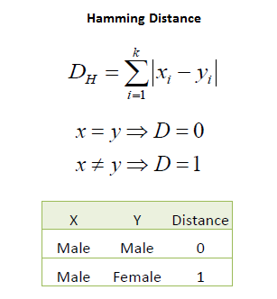
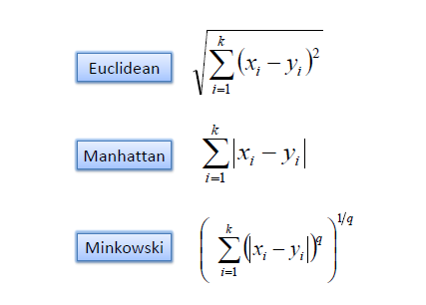
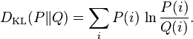
What is Similarity? (how to find the instance x_{i} that is most similar to x_{q})
Distance Metrics
Hamming Distance
Kullback–Leibler Divergence
Continuous Variables
Categorical/Discrete Variables
Measures the information
lost when Q is used to
approximate P

Slide 22
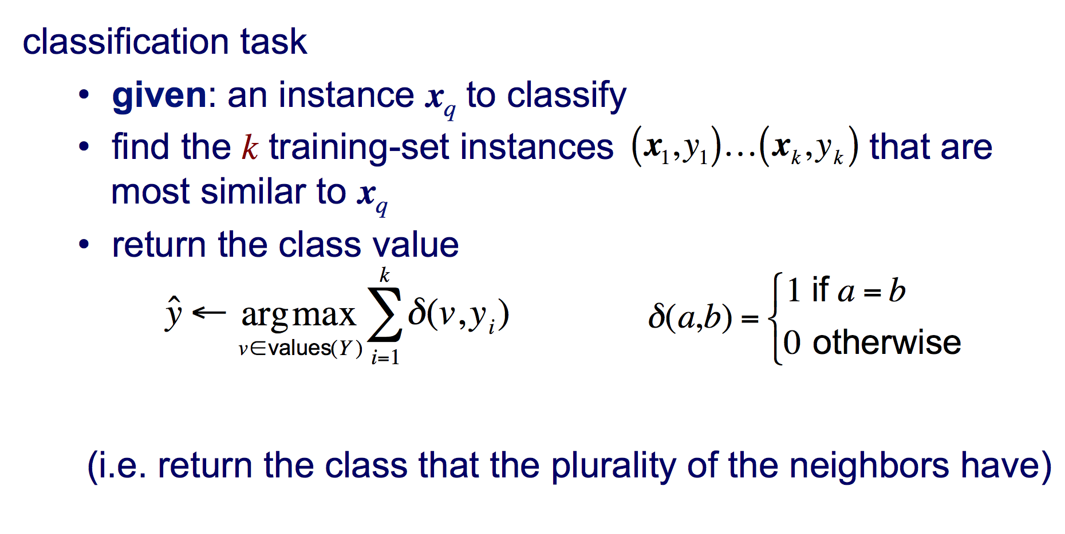
Putting It All Together
voting
Slide courtesy Pedro Domingos

Slide 23
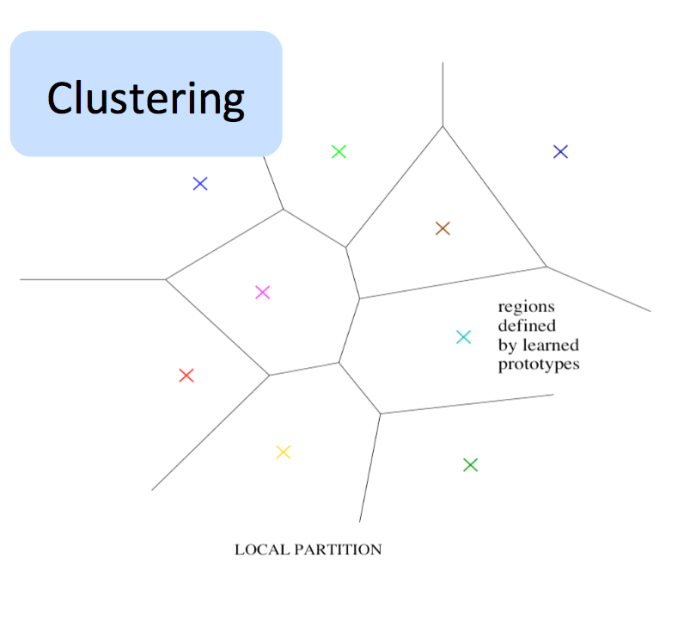
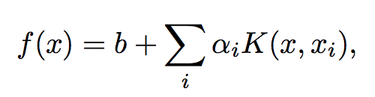
Ok, Why Aren’t We Done?
We want to build statistical models that generalize to unseen cases
Algorithms like k-NN can’t efficiently do this as they are local estimators
Local: The value of the learned function at x depends mostly on training examples that are close to x
Partitions the input space into some number of regions, each with its own set of parameters
But for any interesting target function there can be an exponential number of variations
→ need representative examples for all relevant variations in order to classify them
→ can need an exponential number of parameters and training examples
Local Estimators compute non-distributed representations
Clustering, n-grams, k-NN, RBF SVMs,
local non-parametric density estimation & prediction,
decision trees, kernel machines,…
Need parameter set per distinguishable region
# of distinguishable regions is linear in # of parameters
→ No non-trivial generalization to regions without examples

Slide 24
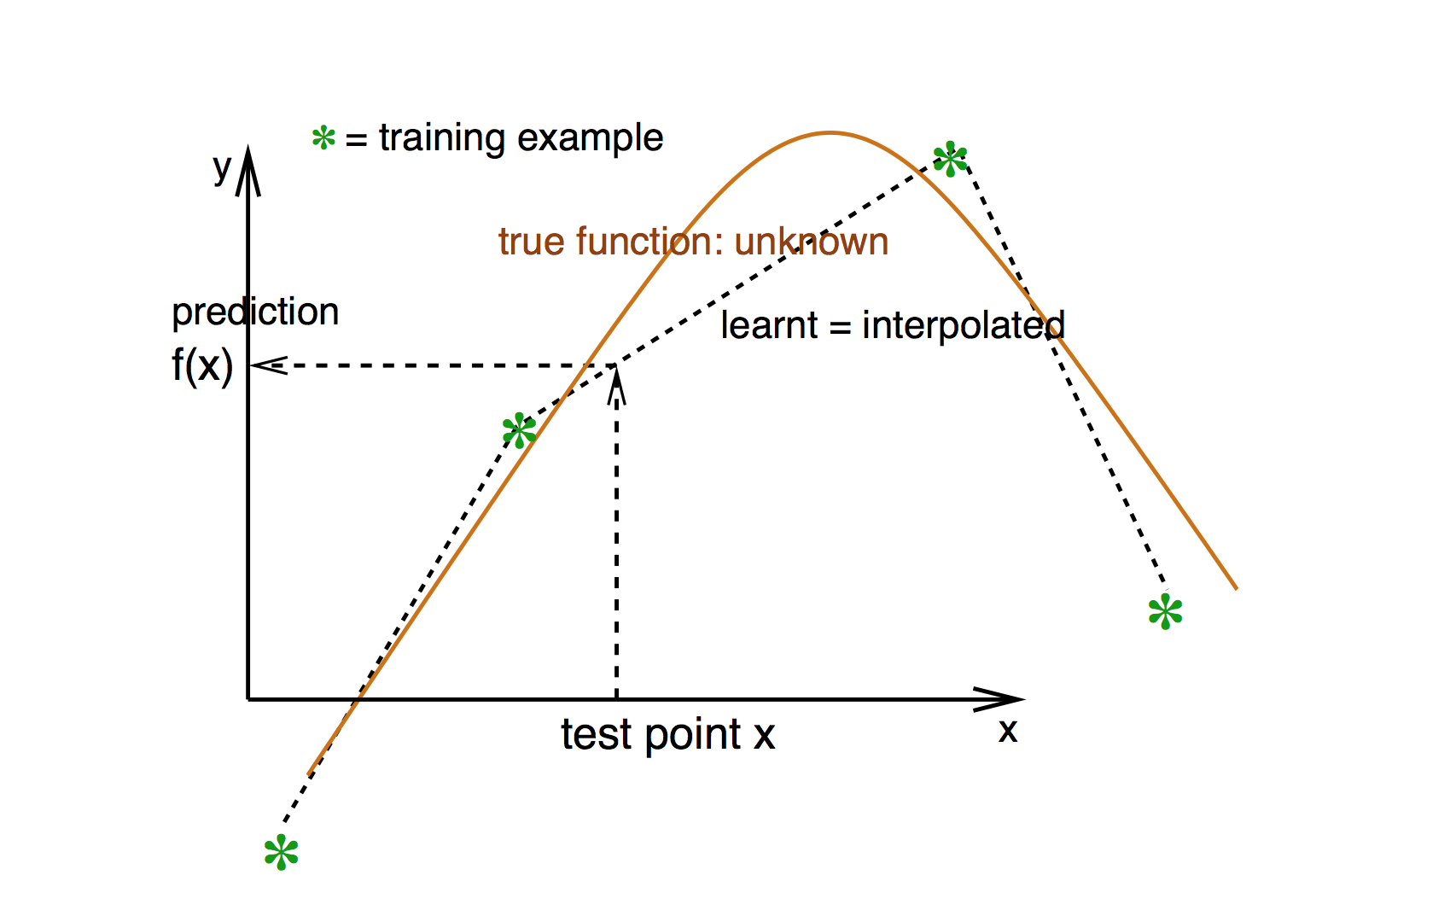
Local Estimation Relies on Smoothness (most basic “prior”)
Smoothness → If x is geometrically close to x’ then f(x) ≈ f(x’)
Graphic courtesy Yoshua Bengio

Slide 25
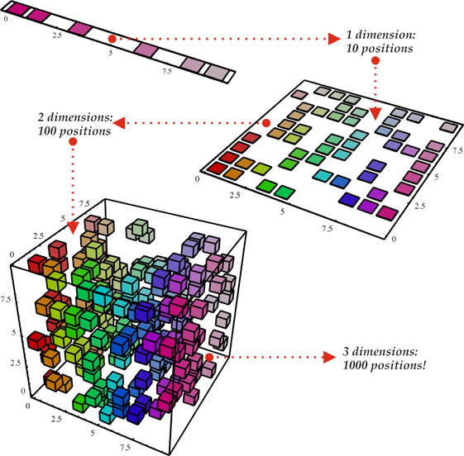
Smoothness, however, cannot defeat The Curse of Dimensionality
(i). Space grows exponentially
(ii). Space is stretched, points become equidistant
Basically: There are exponentially many configurations of the variables to consider

Slide 26
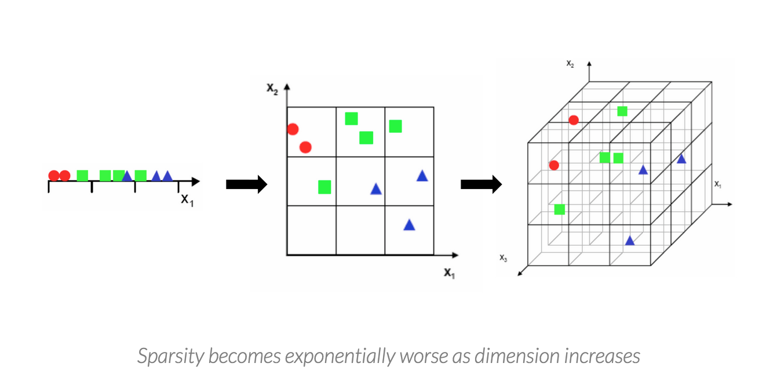
Seen Another Way
The Curse of Dimensionality is what makes generalization hard
(number of variations in the target function grows exponentially)
http://nicolas.le-roux.name/publications/Bengio06_curse.pdf

Slide 27
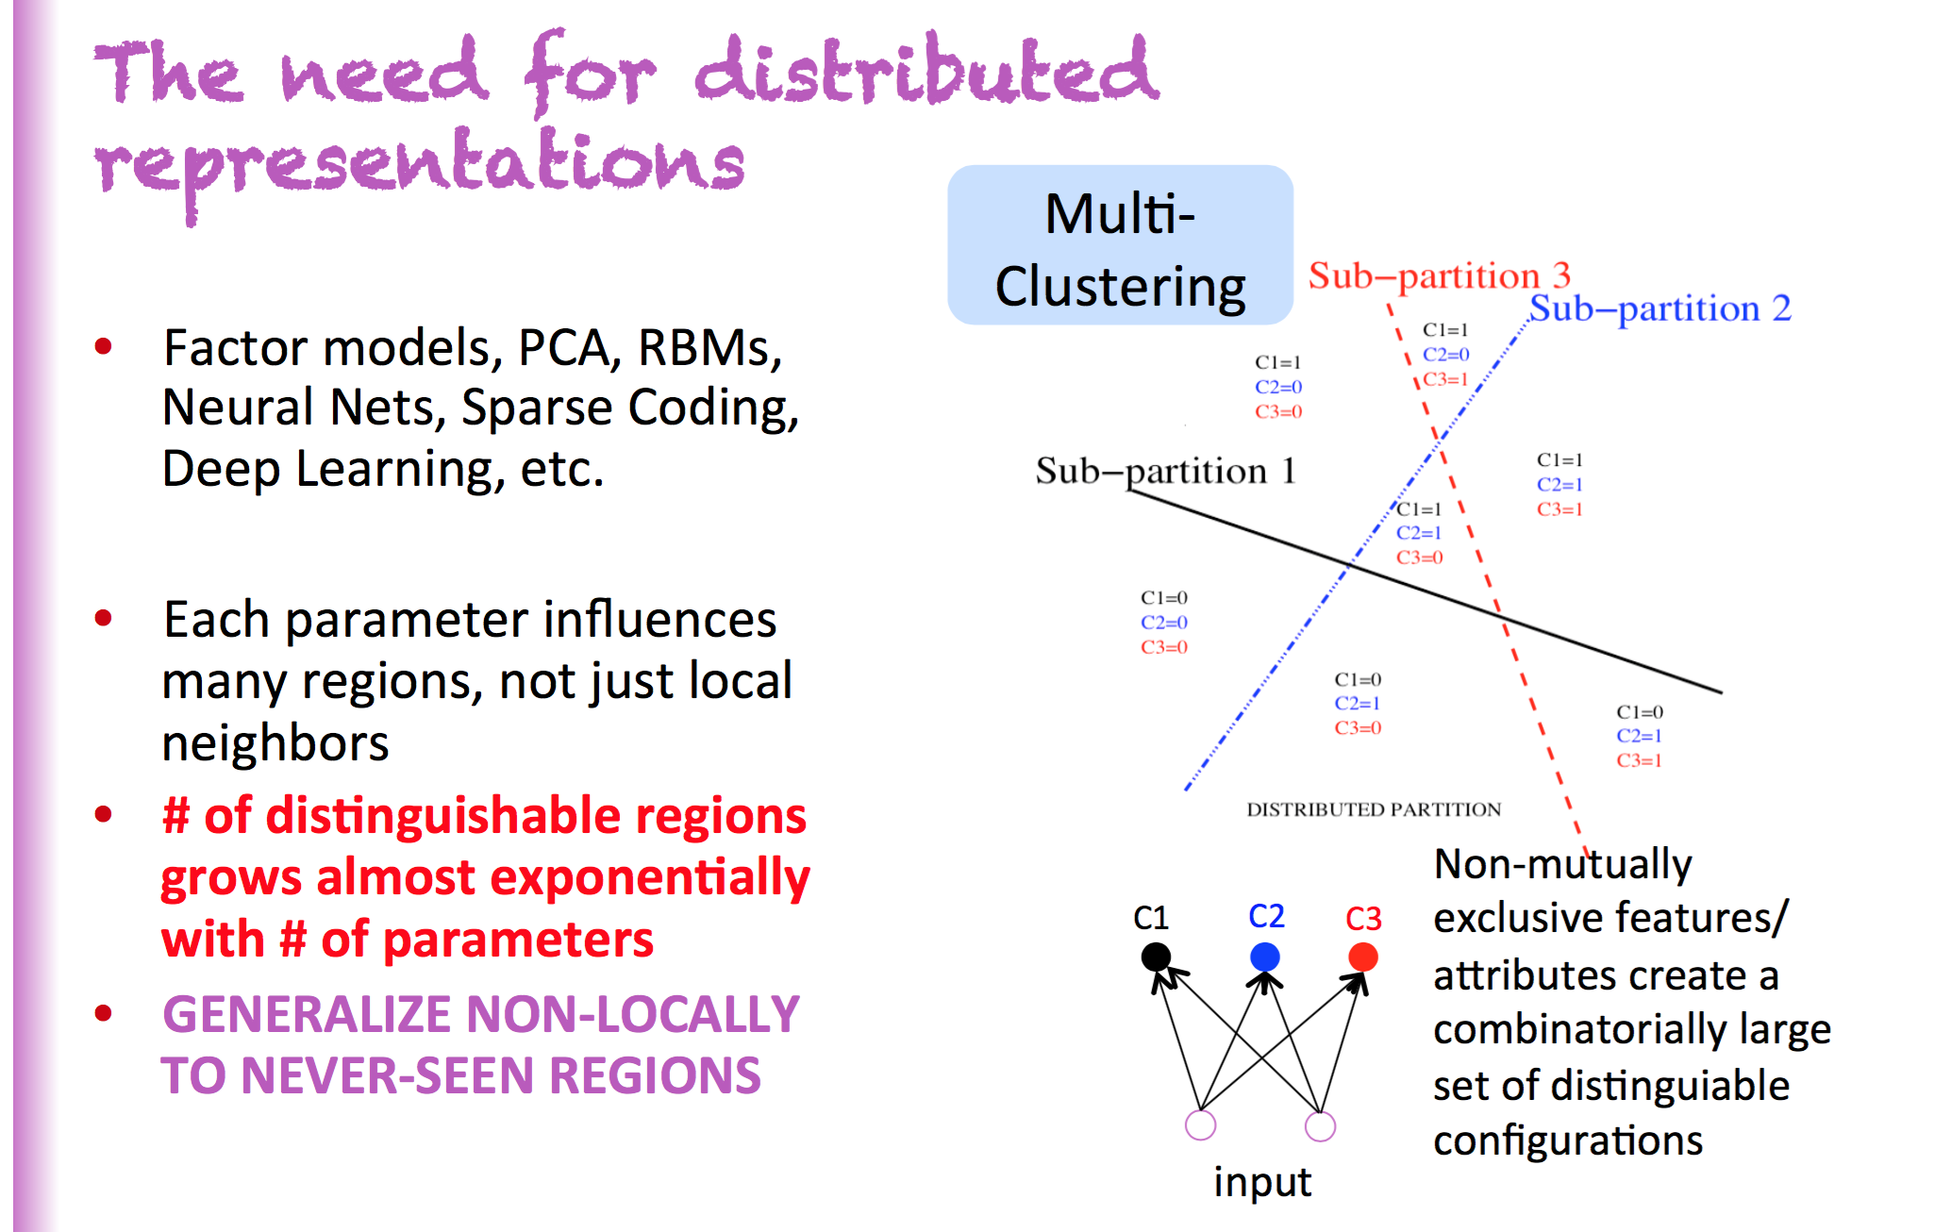
So We Need Distributed Representations
Slide courtesy Yoshua Bengio

Slide 28
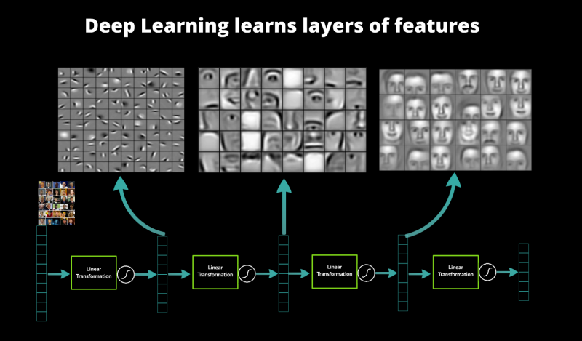
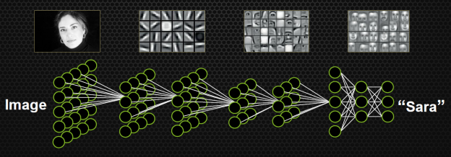
A Bit More on ML Algorithm Representational Power
Voronoi Diagram
Local Estimation
Unique parameters/region
Can be exponentially many regions
Distributed Representation
Reuses “patterns” (e.g., Gabor filters)
Exponentially more powerful that LE

Slide 29
A Few Quick Takeaways
Most “simple” ML algorithms are not distributed
Local Estimators: Clustering, n-grams, NN, RBF SVMs,…
Likely won’t generalize well when data/target function is complex
Distributed representations
can buy exponential gain in generalization
Deep composition of non-linearities
also buys exponential gain in generalization
Both yield non-local generalization
which is what we’re after
So how do we build algorithms and software systems that can
accurately detect a wide variety of anomalies in quasi-real time
mitigate false positive/negatives
generalize to novel attacks

Slide 30







Workflow/Pipeline Schematic
Domain Knowledge
Domain Knowledge
Domain Knowledge
Domain Knowledge
3rd Party Applications
Analytics Platform
Learning
Presentation Layer
Intelligence
Data Collection
Packet brokers, flow data, …
Preprocessing
Big Data, Hadoop, Data Science, …
Model Generation
Machine Learning
Oracle
Model(s)
Remediation/Optimization/…
Oracle
Logic
Intent
Topology, Anomaly Detection,
Root Cause Analysis,
Predictive Insight, ….

Slide 31
Agenda
Introduction 25 minutes
What is an ML application?
So What Are Anomalies?
Anomaly Detection Schemes
A bit on k-Nearest Neighbors
Why algorithms like k-NN or K-Means aren’t the endgame
Derick on Generalization Graphs for Machine Learning 25 minutes
Ed on Anomaly Detection Prototypes 25 minutes
Business Models for ML Discussion
Q&A

Slide 32
Overview
Algorithm developed in-house (potential IP)
Data preparation stage
Built to help capture what is normal, as well as anomalies

Slide 33
Visualization…
Data preparation algorithm for separating anomalies from normal/noise in network flow datasets
Builds a generalization directed graph
DNS anomalies

Slide 34
Generalization
Generalization is the process of replacing specific fields in flow records with generic tags.
Tags represent arbitrary groups of things
Tags harvested from places external to network
IPAM
Puppet/Chef/Ansible/Heat
Firewall ACL/policy names
IANA numbering documents
C&C/botnet lists
IEEE OUI list
Etc and so on and so forth…

Slide 35
Build the Generalization Graph
For each flow, build a directed graph of tag combinations
Start with original flow record (specific)
Add one tag at a time, making graph more general as you move away from original flow record

Slide 36
Generic Generalization Graph
All combinations of four tags
All combinations of three tags
All combinations of two tags
All combinations of one tag
All combinations of zero tags

Slide 37
Adding a Second Flow Part 1
First, let’s replace the bottom two levels with a cloud

Slide 38
Adding a Second Flow Part 2
Gray area has new nodes

Slide 39
Adding a Second Flow Part 3
As flows are evaluated:
A count in each touched vertex is incremented
A count in each touched edge is incremented

Slide 40
What is normal?
“What is normal for ‘internal’ hosts making DNS requests?”
Counts tell us what is normal
Node counts reflect the most common combinations containing “internal” and “53”
Edge counts reflect the most common way in which flows generalize
Doesn’t have to be a strict MAX(count0, count1, …, countN) determination. Can be a probability distribution at a specific level (hosts are configured with multiple DNS servers)

Slide 41
What is abnormal?
This algorithm is part of the data preparation stage of an ML pipeline.
The goal is to isolate potential anomalies away from noise and normal samples as cleanly as possible, so ML algorithms can work effectively.

Slide 42
Visualization: Isolating anomalies
1
5
3
The circles on the circumference of this image are the nodes in the generalization graph
Sets of nodes with numbers next to them represent “normal”
Numbers reflect the number of tags
Anomalies are isolated in the southeast / southeast-east area.
2
4

Slide 43
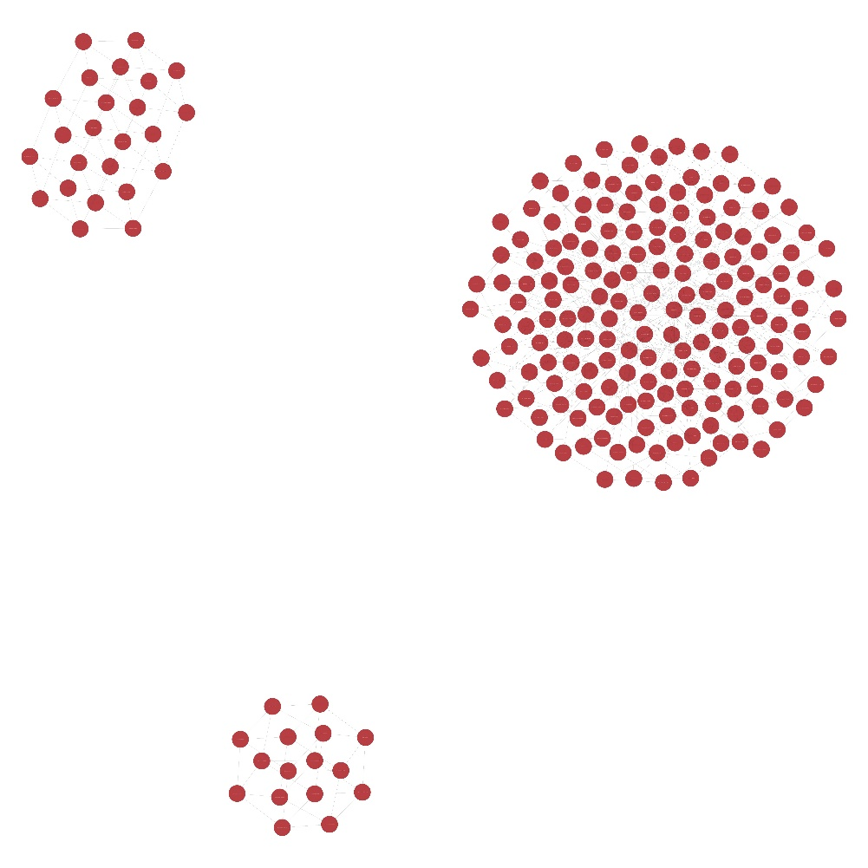
Another Visualization
Anomalies (top-left and bottom) are cleanly separated from normal.

Slide 44
Next steps
Add multiple layers of hierarchy. In this presentation, only a single order of generalization was discussed. (“internal” can be generalized to “host”)
Query syntax to determine what is normal.. A query language for the graph (probably modified version of existing tool)
Validation
Formal description coming (w/ Dave)
ML community validation (under NDA)

Slide 45
Agenda
Introduction 25 minutes
What is an ML application?
So What Are Anomalies?
Anomaly Detection Schemes
A bit on k-Nearest Neighbors
Why algorithms like k-NN or K-Means aren’t the endgame
Derick on Generalization Graphs for Machine Learning 25 minutes
Ed on Anomaly Detection Prototypes 25 minutes
Business Models for ML Discussion
Q&A

Slide 46
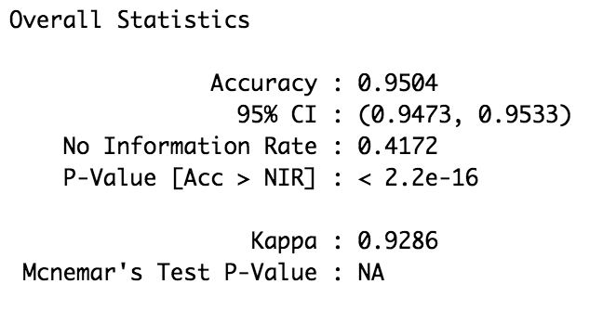
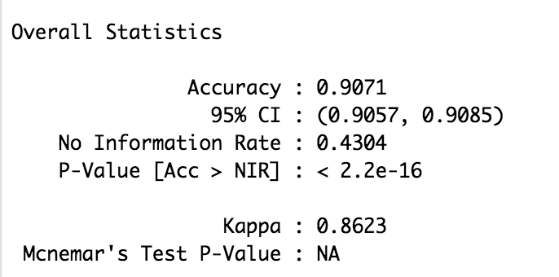
Results
Naïve Bayes
k Nearest Neighbor
2.8 million samples
500,000 samples

Slide 47
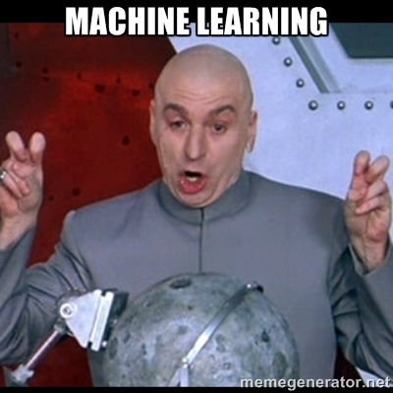
Agenda
Supervised Learning
Why Supervised vs. Unsupervised?
Algorithms
Dataset(s)
Results
Where do we go from here?

Slide 48
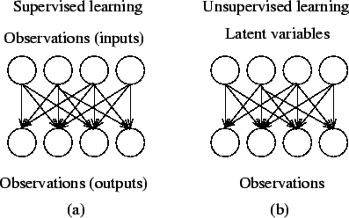
Supervised vs. Unsupervised Learning
Supervised Learning
Defines the effect one set of observations (inputs) has on another set of observations (output)
Unsupervised Learning
All observations assumed to be caused by latent variables (observations assumed to be at the end of the causal chain)

Slide 49
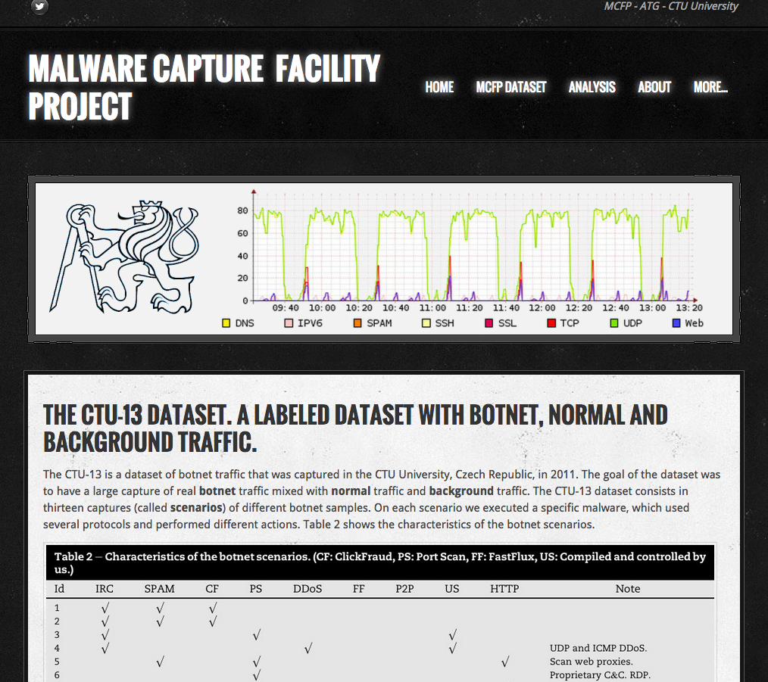
Dataset(s) used for analysis
CTU-13 Dataset
Captured within CTU University (Czech Republic)
Tons of labeled data
Botnets
DDoS
Spam
PortScans
ClickFraud
Etc.
~ 95GB of data
PCAPs
Netflow
ALREADY LABELED (important(sort of))

Slide 50
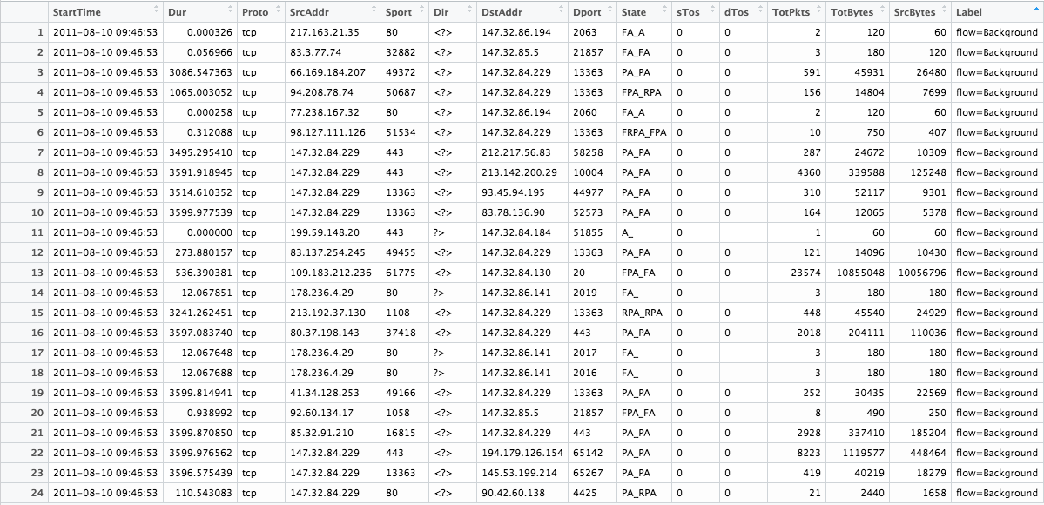
Dataset(s) used for analysis

Slide 51
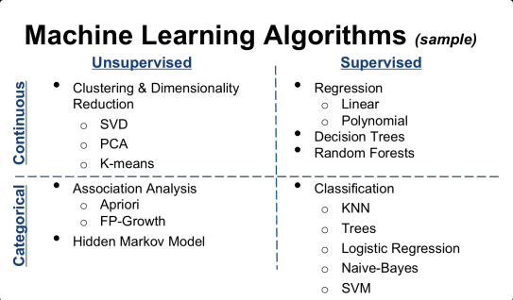
Algorithms
Lots and lots of algorithms
Supervised Learning to start
Occam's Razor
Starting point
k Nearest Neighbors
Naïve Bayes

Slide 52

Naïve Bayes Classifier
Likelihood
Class Prior Probability
Posterior Probability
Predictor Prior Probability
P(Y|X) = P(Y)P(X|Y) / P(X)? – maybe rewrite like this?

Slide 53

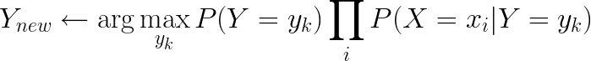
Naïve Bayes Algorithm
For each value y_{k}
Estimate P(Y = y_{k}) from the data.
For each value x_{ij} of each attribute X_{i}
Estimate P(X_{i}=x_{ij} | Y = y_{k})
Classify a new point via:
In practice, the independence assumption doesn’t often hold true, but Naïve Bayes performs very well despite it.

Slide 54
Naïve Bayes Classifier
Zero Frequency problem (Laplace Estimator) :
Add 1 to every count when an attribute value doesn’t occur.
Real Example over 2.8mil rows :
w/o Estimator : Accuracy = ~90%
w/ Estimator : Accuracy = ~95%
Frequency Table
SrcIP | Label
 | Background | Botnet
147.32.84.229 | 3 | 2
147.32.84.165 | 4 | 0
83.137.254.245 | 2 | 3
P(x|C) = P(142.32.84.229 | Background) = 3/9 = 0.33
Likelihood Table
SrcIP | Label
 | Background | Botnet
147.32.84.229 | 3 / 9 | 2 | 5/14
147.32.84.165 | 4 / 9 | 0 | 4/14
83.137.254.245 | 2 / 9 | 3 | 5/14
 | 9/14 | 5/14
P(x) = P(142.32.42.229)
= 5/14 = .36
P(C) = P(Background)
= 9/14 = 0.64
Posterior Probability : P(C|x) = P(Background | 142.32.84.229) = 0.33 x 0.64 / 0.36 = 0.60

Slide 55
Where do we go from here? (think systems approach)
Algorithms
Ensembling
Averaging multiple models run against datasets
Regularizer (!)
Largest kaggle entry I’ve seen contained 3 levels of over 40 models run against roughly 93 engineered features
Unsupervised Learning
Latent feature discovery
Data
All infrastructure should be considered sensors
More data = more better (most of the time)
More Compute (GPU and CPU)
Roughly ~4 hours run-time for 2.8mil rows of data
Corollary (more efficient implementations of algorithms)
Micro / mini-batch processing
Systems approach
Data pipeline
Acquisition
ETL
ML
Optimization / Remediation
Telemetry
Robust telemetry across entire portfolio
Meaningful acquisition methodologies
IPFIX / Netflow
Direct API interaction
LSDC (Varma) / Elmer (Derick / Matt Stone)
SNMP (☹)
NETCONF
Syslog
Thermometers
Counters
Configuration Data
Chef / Puppet / Heat / Ansible / etc.

Slide 56
Agenda
Introduction 25 minutes
What is an ML application?
So What Are Anomalies?
Anomaly Detection Schemes
A bit on k-Nearest Neighbors
Why algorithms like k-NN or K-Means aren’t the endgame
Derick on Generalization Graphs for Machine Learning 25 minutes
Ed on Anomaly Detection Prototypes 25 minutes
Q&A

Slide 57
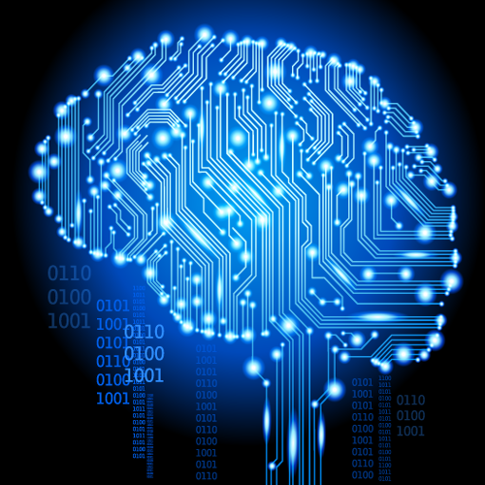
Q&A
Thanks!

